Slide 1
Safe and Facilitated Goods Movement through the Black and Baltic Sea Transport Corridor
Kyiv, 18 October 2011

Slide 2
Consulting Group Mission (2012-2013)
Development of cooperation between state bodies and private persons in adoption of electronic technologies and practices required for implementation of intellectual and integrated railway corridors between Europe and Eurasia.
Notes:
We are participating in today’s conference because we believe our new regional program will not only be in line with the OSCE’s goals for the development of sustainable energy and transport projects, but offers a strong starting point for a new regional effort overseen by the OSCE or another regional organization seeking improved transport and energy solutions for the region. We believe the key to meeting this conference’s economic and environmental goals for regional transport are NOT sustainable without a significant enhancement in the degree of integration between East and West transport corridors. We think that rail corridors represent the best environmental choice for inland transport and represent a greatly overlooked opportunity for creating intelligent and integrated transport links between Europe and Eurasia.

Slide 3
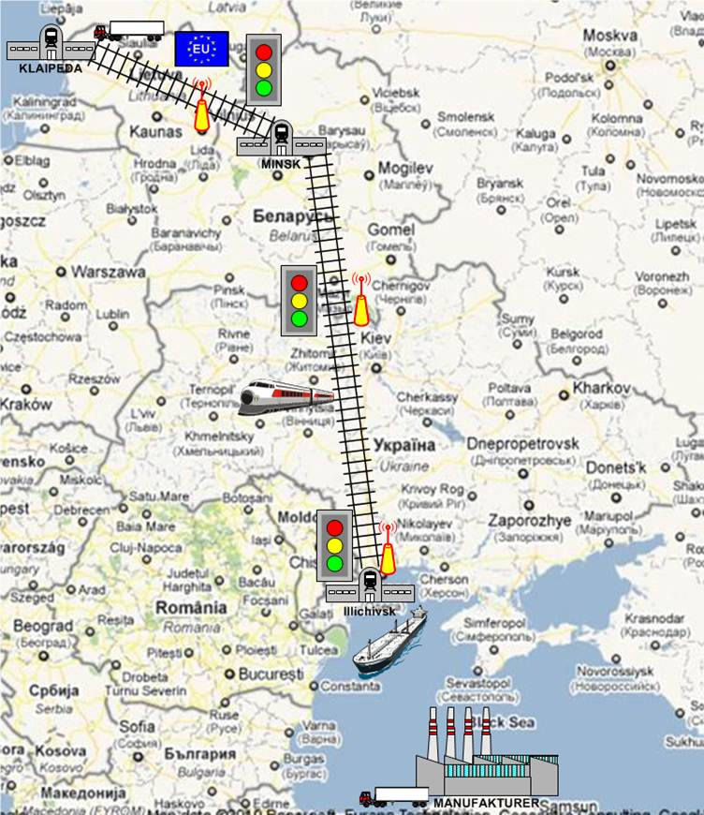
Pilot Project
“Viking” Rail Line
Notes:
Briefly introduce our joint US and Lithuanian advisory team and our current project which will be holding its ceremonial kick-off in less than a month. The project is based on the existing Viking Rail Line between the Black Sea and the Baltic Sea. The problem the rail line faced was quite simple [over]

Slide 4
Pilot “Viking”
So far the three state (Ukraine, Bilorus and Lithuania) have:
Agreement of Accelerated Cargo Movement by Rail Line;
Supervisory Committee of the state and private interested circles;
Customs services adopting the electronic customs declarations processing technology and procedures and the best risk analysis practices for the purpose of cargo movement acceleration.
Working with private consignors and transportation companies for the purpose of ensuring introduction of electronic seals and follow-up devices that will operate along the whole rail corridor.
The US Department of State will provide additional electronic seals and reading devices after procedural testing; Experts of the Lithuanian Customs House will work as consultants/instructors on the electronic signature and electronic customs projects.
Notes:
In addition, Russia (Office of Kaliningrad Governor ) and Turkey have participated in committee meetings and would form a second phase of the expedited rail pilot.

Slide 5
Problem
In consideration of cost and timeliness problems and other risks consignors avoided the VIKING Line between the Black Sea and Northern Europe
Notes:
Read above……….Shippers have instead chosen truck shipments (this can be seen by the Turkish truck traffic and other alternative shipping between the Black Sea region and Northern Europe.

Slide 6
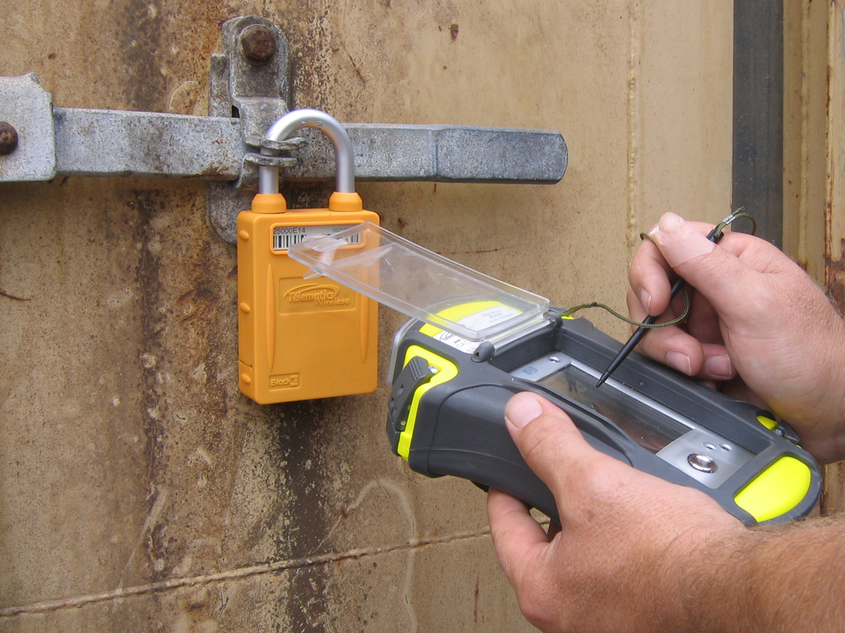
Goals of the Program
State and private partnership in
intellectual Transport
Radio-frequency identification technology / RFID
GPS technology for containers
Internal Reporting Standards of Rout Emission
Accelerated movement of cargo by railway
Unified electronic customs declarations
Assistance in development of the analysis of risks characteristic for rail corridors
Notes:
A joint US-Lithuanian advisory team will implement following…

Slide 7
Facilitation, Exchange of Electronic Data and Joint Work of Organisations Operating in Ports

Slide 8
Expected Facilitation
Introduction of principles of Single Stop, Single Window and other simplifications in goods customs clearance.
Development of simple, transparent and relevant procedures as a means of eliminating corruption favourable conditions.
Facilitation of electronic information exchange including private sector based on international standards.

Slide 9
Main Priorities
Electronic declaring
Joint work of border bodies - Single Window
Control based on risk analysis findings
Control coordination - One Stop Shop principle

Slide 10
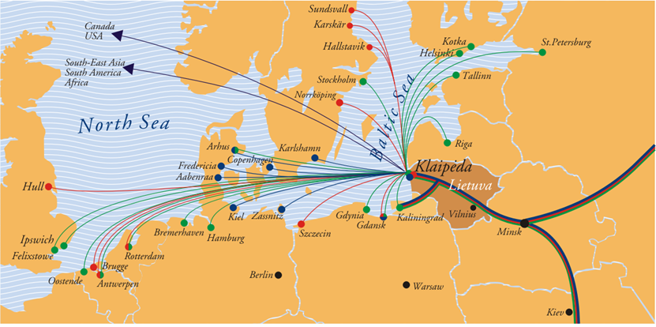
Klaipeda Port – Geographical Location and Transport Communications
Notes:
The seaport of Klaipeda, which is a port of international importance as a major cargo transhipment and passenger transport centre, creates favourable conditions for the rapid economic development of the Klaipeda region and makes the region more attractive for foreign investment. Both its geographical position and the fact of being a transit sea country can help Lithuania become an ideal “ gateway” into international markets
The port of Klaipeda is the leader among the ports of the Baltic Sea in terms of container handling. Its well- coordinated operations of sea and hinterland transport, the EU short- sea shipping network, and wide- range operation of logistic and industrial enterprises ensure the operations of intermodal transport.
Good geographical position is’nt enought for good transport servise. Business and state institutions have to create simple and favourable conditions for movement of legal goods .

Slide 11
Problems
More than 40 types of paper documents
The same data are repeated in various documentation
The same documents copies are to be submitted to different institutions
Various methods data exchange between partners
Manual entering of the same data in other ICs
Information delays impede cargo handling
Human factor and operators’ mistakes
Absence of statistical data
Notes:
Today, I hope in nearest future we can say –yesterday- in the port are using a lot of different paper documents.
40 different type of paper documents
The same data repeats in different documents
Different institutions have to be provided with the copies of the same documents
Many points for submition of information about cargo
Different methods of data exch. between partners
Manual entering of the same data into different IS
Information delays causing delays in cargo handling
Human factor and human mistakes
Lack of statistics data.
The processes in the port became difficult for all participants: for business, for agencies and institutions. We had 4 W – What, who, where and when we have to do for solving this problem.
And with great pleasure I relinquish floor for Algimantas Žygus

Slide 12
Port Community
Over 60 forwarding agencies
Over 70 transportation and forwarding enterprises
22 stevedore enterprises
LLC LITHUANIAN RAILWAY (principal carrier, 70% of cargoes.)
Klaipeda Territorial Customs House
Klaipeda Health Centre
State Plants Protection Service
State Food and Veterinary Service
State Border Service
Department of Fishery on the Basis of Ministry of Agriculture
Klaipeda State Sea Authority
Notes:
Port community is very wide. All these institution and business companies have to communicate and use a lot of various document in different processes of carrying goods through the port.

Slide 13
KIPIS – INSTRUMENT OF COMMUNICATIONS AND FACILITATIONS
KIPIS is an information system for date exchange between the port companies and state institutions participating in cargo clearance and check-up within Klaipeda Port.
KIPIS Goals:
Facilitation of port processes with the use of modern information technologies accelerating cargo movement through Klaipeda Port. Increasing efficiency and competitiveness of the Klaipeda Sea Port

Slide 14
Group of KIPIS Users
Klaipeda Health
Centre
State Veterinary Service
State Border
Service
Lithuanian
Customs
State Plant
Protection Service
Ship owners
Cargo forwarders
Stevedore enterprises
(port terminals)
KIPIS
Lithuanian Railway
Ship’s documents,
Shipping documents,
Warehousing documents,
************************
************************
Certificates, sheets, etc.
Klaipeda State Sea Port

Slide 15
Contacts
Consulting Group for Trade and Transport Security and Facilitation
Valdas Dovidenas, Consultant
Mob. tel.: +380674475242
E-mail: valdas.dovydenas@gmail.com
Vitenis Alisauskas, Consultant
Mob. tel.: +37061499200
E-mail: vytenis.alisauskas@gmail.com

