Slide 1
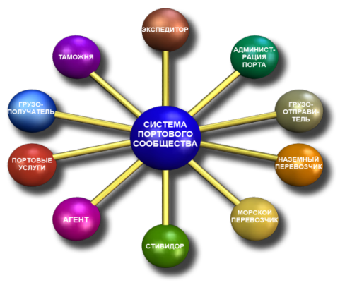
Single information port community system of Odessa port
Presentation of competent maintenance

Slide 2
1. Work staging
Port administration
Agent
Forwarder
Agent
Customs
notices
1
1
2
2
3
2,3
4
ЕИС ПС
Single information port community system

Slide 3
2. Participants of first stage
Port administration
- Execution of ship entry
Forwarder
- Execution of orders
Agent(Line)
- Sighting of orders
State customs service of Ukraine (Odessa - port)
- Sighting of orders

Slide 4
3. Necessary things for participation
- PC MS Windows 7
- Electronic digital signature with «Electronic customs declaring»
- Internet connection
Things that will be installed/adjusted at work station
- Canal VPN on server of Single information port community system (IP Sec)
- Libraries of Electronic digital signature
- Software of work station of Electronic digital signature

Slide 5
4. Which information will be transferred and to whom it will be available
Document | Owner | Consumer
List of vessels entry | Port administration | Forwarders
- Orders | Forwarders | Agents, State customs service of Ukraine, Port administration
- Line visa | Agents | State customs service of Ukraine, Forwarders, Port administration
- Visa of State customs service of Ukraine | State customs service of Ukraine | Agents, Forwarders, Port administration

Slide 6
5. Information protection
- Multilevel authentication
- VPN
- REST
- Electronic digital signature (PKCS #7)
- Competence with Laws of Ukraine «Electronic workflow» и «Electronic signature»
- System certification in State service of technical information protection

Slide 7
6. Testing order 8.10.2012
Execution of one order in all involved organizations:
Forwarder
Adjustment of work station, Installation of software, Study
Execution of order in Single information port community system
Agent
Adjustment of work station, Installation of software, Study
Order visa
State customs service of Ukraine
Adjustment of work station, Installation of software, Study
Order visa
Cancellation of formation of order in inverse order
State customs service of Ukraine
Execution of visa cancellation
Agent
Execution of visa cancellation
Forwarder
Order cancellation

Slide 8
Single information port community system
Thank you for your attention!

